Slide 1
Chapter 7:
Advanced SQL
Modern Database Management
10th Edition
Jeffrey A. Hoffer, V. Ramesh,
Heikki Topi
© 2011 Pearson Education, Inc. Publishing as Prentice Hall

Slide 2
Objectives
Define terms
Write single and multiple table SQL queries
Define and use types of joins
Write noncorrelated and correlated subqueries
Establish referential integrity in SQL
Understand triggers and stored procedures
Discuss SQL:200n standard and its extension of SQL-92
Notes:
So far, we learned how to retrieve data from one table, we will learn of to retrieve data from multiple talbes
We will cover three types of joins

Slide 3
Processing Multiple Tables–Joins
Join–a relational operation that causes two or more tables with a common domain to be combined into a single table or view
Equi-join–a join in which the joining condition is based on equality between values in the common columns; common columns appear redundantly in the result table
Natural join–an equi-join in which one of the duplicate columns is eliminated in the result table
The common columns in joined tables are usually the primary key of the dominant table and the foreign key of the dependent table in 1:M relationships
Notes:
JOIN : an operation to link entities and relationships together for data retrieval
EQUI-JOIN : join based on equality
NATURAL JOIN: equi-join in which one of the duplicate column is eliminated in the result table

Slide 4
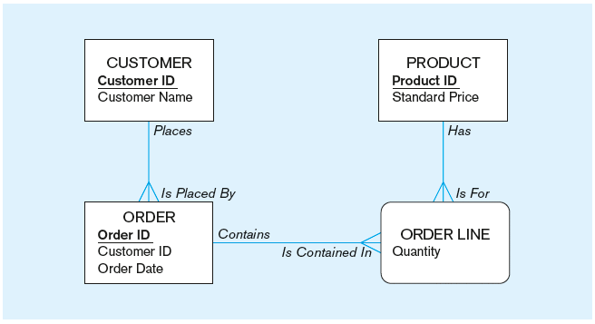
The following slides create tables for this enterprise data model
(from Chapter 1, Figure 1-3)

Slide 5
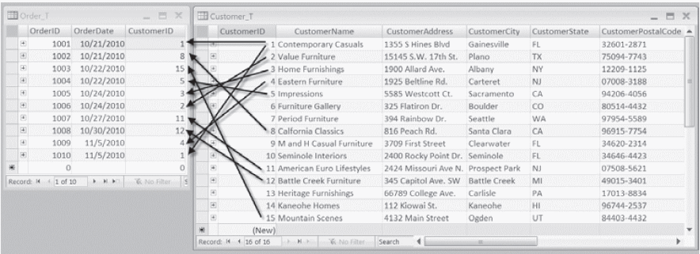
Figure 7-1 Pine Valley Furniture Company Customer_T and Order_T tables with pointers from customers to their orders
These tables are used in queries that follow
Notes:
Example of 1:M relationship.
Customer ID 1 has 2 orders
CustID 2 has only 1 order
Cust ID 3 only 1 order, 7 no order
Overall, some customers have not orders, some customers have only one order, etc.

Slide 6
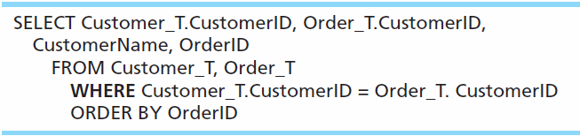
Equi-Join Example
For each customer who placed an order, what is the customer’s name and order number?
Customer ID appears twice in the result
Notes:
How do you return a result set of all customer with orders
Equi join is based on equality

Slide 7
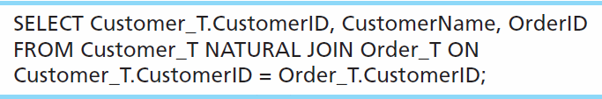
Natural Join Example
For each customer who placed an order, what is the customer’s name and order number?
Join involves multiple tables in FROM clause
ON clause performs the equality check for common columns of the two tables
Note: from Fig. 7-1, you see that only 10 Customers have links with orders
➔ Only 10 rows will be returned from this INNER join
Notes:
Postgress, MySQL, and Oracle support Natural joins. SQL Server and DB2 do NOT

Slide 8
Books version: Three Types of JOIN
Natural JOIN – not supported by many vendors, can be achieved via INNER JOIN
Equi JOIN - not need to differentiate joins based on equality. Other operators such as >=, <=, <> between etc.
UNION JOIN - commonly referred to as FULL JOIN

Slide 9
Practical Version: Four Types of JOINS
INNER JOIN
OUTER JOIN
  LEFT OUTER JOIN
  RIGHT OUTER JOIN
FULL JOIN

Slide 10
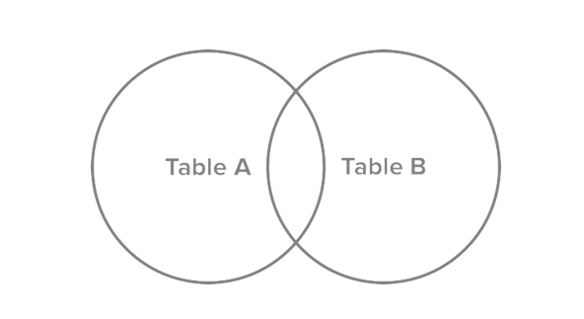
JOINS visualization

Slide 11
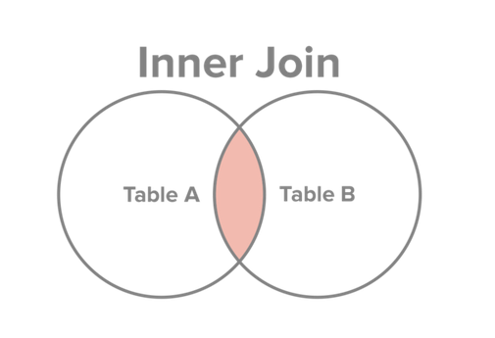
INNER JOIN
Select all records from Table A and Table B, where the join condition is met.
http://www.sql-join.com/sql-join-types/

Slide 12
INNER JOIN SQL
SELECT c. CustomerID, c.CustomerName, o.OrderID
FROM Customer_T c INNER JOIN ORDER_T AS o ON c.CustomerID = o.CustomerID
Key word INNER is optional:
SELECT c. CustomerID, c.CustomerName, o.OrderID
FROM Customer_T c JOIN ORDER_T AS o ON c.CustomerID = o.CustomerID
Notes:
This query returns only customers that have orders,
If a customer doesn’t have orders it doesn’t show up

Slide 13
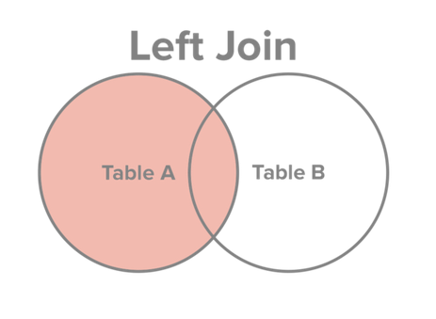
JOINS: LEFT OUTER JOIN
Select all records from Table A, along with records from Table B for which the join condition is met (if at all).
http://www.sql-join.com/sql-join-types/

Slide 14
LEFT OUTER JOIN SQL
SELECT c. CustomerID, c.CustomerName, o.OrderID
FROM Customer_T c LEFT OUTER JOIN ORDER_T AS o ON c.CustomerID = o.CustomerID
Key word OUTER is optional:
SELECT c. CustomerID, c.CustomerName, o.OrderID
FROM Customer_T c LEFT JOIN ORDER_T AS o ON c.CustomerID = o.CustomerID
Notes:
This query returns only customers that have orders,
If a customer doesn’t have orders it doesn’t show up

Slide 15
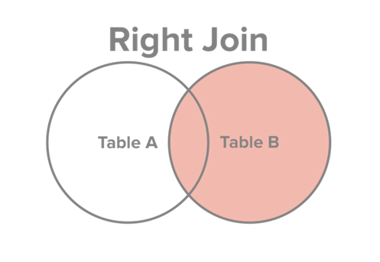
JOINS: RIGHT OUTER JOIN
Select all records from Table B, along with records from Table A for which the join condition is met (if at all).
http://www.sql-join.com/sql-join-types/

Slide 16
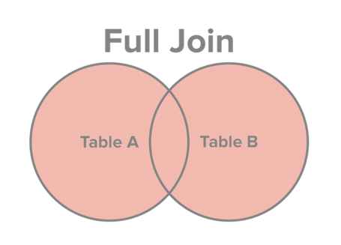
JOINS: FULL JOIN
Select all records from Table A and Table B, regardless of whether the join condition is met or not.
http://www.sql-join.com/sql-join-types/

Slide 17
FULL JOIN SQL
SELECT c. CustomerID, c.CustomerName, o.OrderID
FROM Customer_T c FULL JOIN ORDER_T AS o ON c.CustomerID = o.CustomerID
Notes:
This query returns only ORDERS orders,
If a customer doesn’t have orders it doesn’t show up

Slide 18
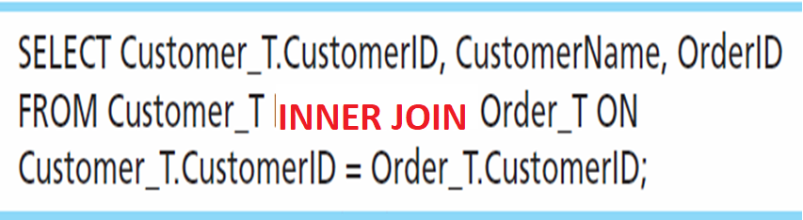
Inner Join Example
For each customer who placed an order, what is the customer’s name and order number?
Join involves multiple tables in FROM clause
ON clause performs the equality check for common columns of the two tables
Note: from Fig. 7-1, you see that only 10 Customers have links with orders
➔ Only 10 rows will be returned from this INNER join
Notes:
In this example will only return rows where customers have orders.

Slide 19
Different JOIN syntax
SELECT Custsomer_T.CustomerID, CustomomerName, OrderID
FROM Customer_T INNER JOIN Order_T ON Customer_T.CustomerID = Order_T.CustomerID
SELECT Custsomer_T.CustomerID, CustomomerName, OrderID
FROM Customer_T, Order_T
WHERE Customer_T.CustomerID = Order_T.CustomerID
Notes:
Implicit and explicit JOIN notations
Implicit JOIN notation -> no longer considered best practice!
Which syntax is better, the one on top, the other is prior SQL 92 standards.

Slide 20
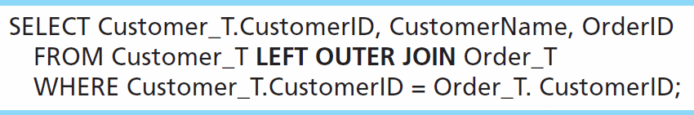
Outer Join Example
List the customer name, ID number, and order number for all customers. Include customer information even for customers that do have an order.
LEFT OUTER JOIN clause causes customer data to appear even if there is no corresponding order data
Unlike INNER join, this will include customer rows with no matching order rows

Slide 21
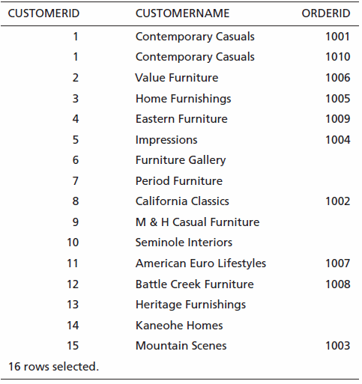
Results
Unlike INNER join, this will include customer rows with no matching order rows

Slide 22
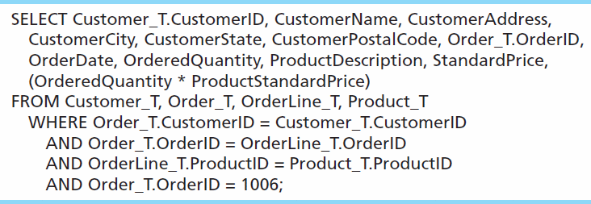
Multiple Table Join Example
Assemble all information necessary to create an invoice for order number 1006
Four tables involved in this join
Each pair of tables requires an equality-check condition in the WHERE clause, matching primary keys against foreign keys

Slide 23
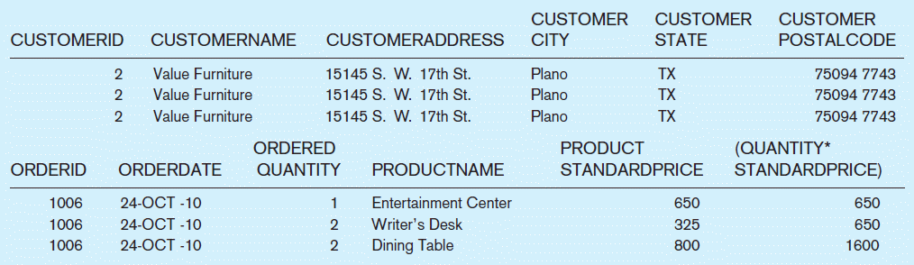
Figure 7-4 Results from a four-table join (edited for readability)
From CUSTOMER_T table
From ORDER_T table
From PRODUCT_T table

Slide 24
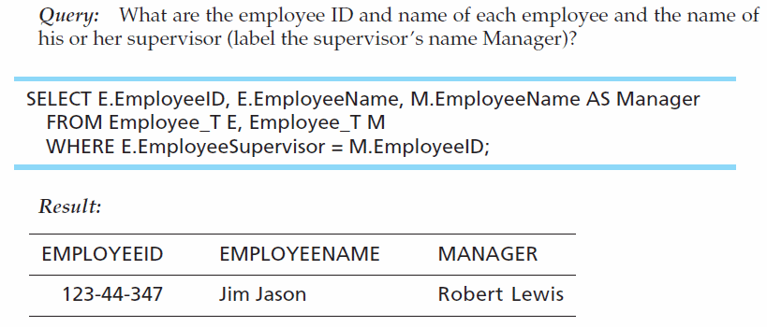
Self-Join Example
The same table is used on both sides of the join; distinguished using table aliases
Self-joins are usually used on tables with unary relationships
Notes:
Use of alias

Slide 25
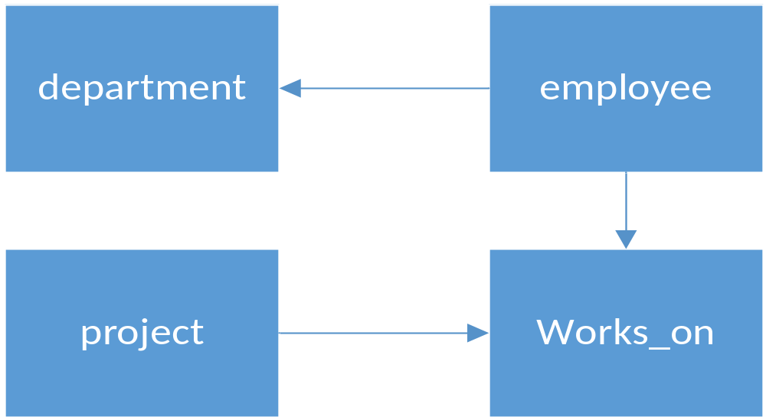
JOIN Exercise 1: example from previous lecture
Write a SQL query to return employee names ( first and last) and the location of their work ( from department).
Notes:
SELECT e.emp_fname, e.emp_lname, d.location
FROM department d JOIN employee e on e.dept_no = d.dept_no

Slide 26
JOIN Exercise 2: example from previous lecture
Write a SQL query to return employee names (first and last) and their job function for the project they work(ed) on. Display blank for employees with no projects.
Notes:
SELECT e.emp_fname, e.emp_lname, w.job
FROM employee e left join works_on w on e.emp_no = w.emp_no

